Slide 1
HELM Basics

Slide 2
Helm – A package manager for Kubernetes
What is a package manager?
Automates the process of installing, configuring, upgrading, and removing computer programs
Examples: Red Hat Package Manager (RPM), Homebrew, Windows Pkgmgr/PackageManagement
Helm enables multiple Kubernetes resources to be created with a single command
Deploying an application often involves creating and configuring multiple resources
A Helm chart defines multiple resources as a set
An application in Kubernetes typically consists of (at least) two resource types
Deployment – Describes a set of pods to be deployed together
Services – Endpoints for accessing the APIs in those pods
Could also include ConfigMaps, Secrets, Ingress, etc.
A default chart for an application consists of a deployment template and a service template
The chart creates all of these resources in a Kubernetes cluster as a set
Rather than manually having to create each one separately via kubectl
Notes:
Helm is a package Manager
Automates the installation, configuration, upgrade and removing of Apps
Deploys the App and its Configuration
The App and its Config are packaged in a so called Chart
At least two resource types: Deployment and Services (Secrets, ConfigMap)
You avoid creating each resource manually using kubectl

Slide 3

Helm Terminology
Helm – The CLI
Helm installs charts into Kubernetes, creating a new release for each installation
Chart – The application package
Templates for a set of resources necessary to run an application
Includes a values file to configure resources
Repository – The library
Storage for Helm charts
stable – The namespace of the hub for official charts
Release – The application runtime
An instance of a chart running in a Kubernetes cluster
Tiller – The server-side engine
Helm templating engine, runs in a pod in a Kubernetes cluster
Processes the chart to generate the resource manifests, then installs the release into the cluster
Stores each release as a Kubernetes config map
Chart (templates)
Values (config)
install
Kubernetes cluster
Release
(resources)
Tiller
Notes:
Helm is the CLI
Helm creates a new release for each installation (versioning: rollback)
Chart is the application package
Repository is the library: Just a web server
Release is the application runtime: An instance of a Chart
Tiller is the server side. Runs in a pod.

Slide 4
Advantages of using Helm
Deploy all the resources for an application with a single command
Makes deployment easy and repeatable
$ helm install <chart>
Separates configuration settings from manifest formats
Edit the values without changing the rest of the manifest
values.yaml – Update to deploy the application differently
Upgrade a running release to a new chart version
$ helm upgrade <release> <chart>
Rollback a running release to a previous revision
$ helm rollback <release> <revision>
Delete a running release
$ helm delete <release>
Kubernetes cluster
Chart
myapp v1
install
Release
myapp r1
upgrade
rollback
Chart
myapp v2
(upgrade)
Release
myapp r2
delete
Notes:
Deploy all resources with a single command
Can use variables to deploy same App with new parameters
Upgrade to a new version of your chart
Rollback
Delete as a whole

Slide 5
Installing Helm
Helm runs as a CLI client
Typically installed on your laptop
https://docs.helm.sh/using_helm/#installing-helm
Options for installing Helm
Download the release, including the binary from:
https://github.com/kubernetes/helm/releases
Homebrew on MacOS
brew install kubernetes-helm
Installer script
curl https://raw.githubusercontent.com/kubernetes/helm/master/scripts/get > get_helm.sh

Slide 6
Helm commands
Install Tiller
$ helm init
Create a chart
$ helm create <chart>
List the repositories
$ helm repo list
Search for a chart
$ helm search <keyword>
Info about a chart
$ helm inspect <chart>
Deploy a chart (creates a release)
$ helm install <chart>
List all releases
$ helm list --all
Get the status of a release
$ helm status <release>
Get the details about a release
$ helm get <release>
Upgrade a release
$ helm upgrade <release> <chart>
Rollback a release
$ helm rollback <release> <revision>
Delete a release
$ helm delete <release>

Slide 7
Working with repositories
$ helm repo list
NAME URL stable https://kubernetes-charts.storage.googleapis.com/
$ helm search jenkins
NAME VERSION DESCRIPTION stable/jenkins 0.1.14 A Jenkins Helm chart for Kubernetes.
$ helm repo add my-charts https://my-charts.storage.googleapis.com $ helm repo list
NAME URL stable https://kubernetes-charts.storage.googleapis.com/ my-charts https://my-charts.storage.googleapis.com

Slide 8
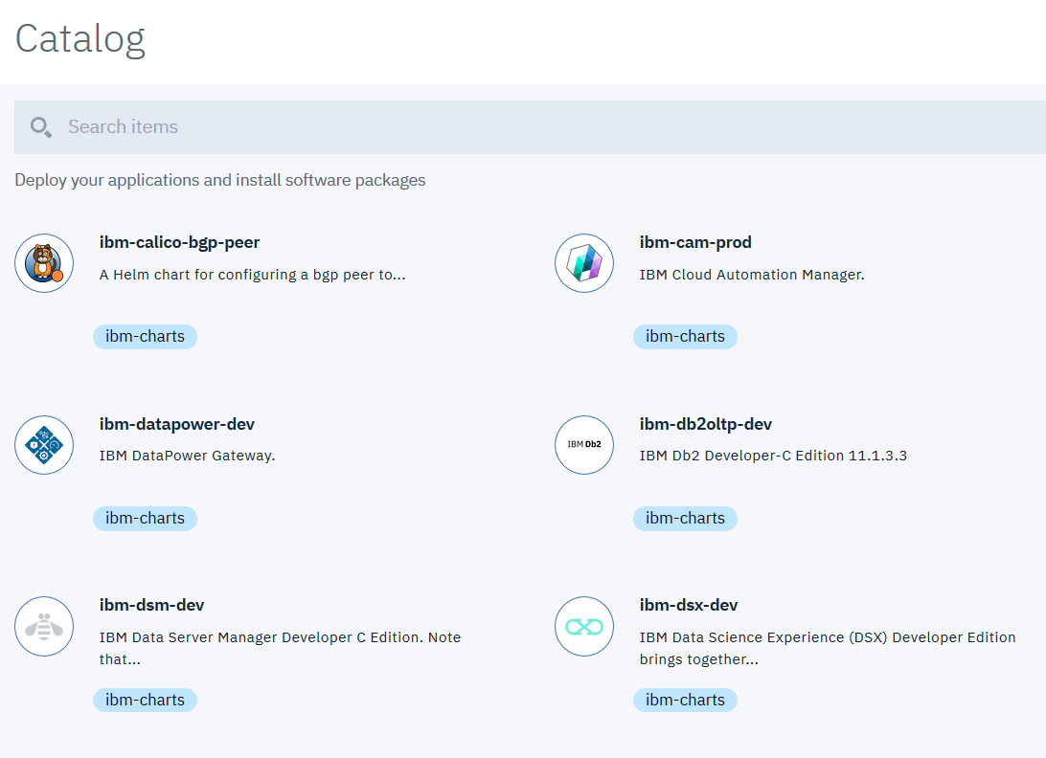
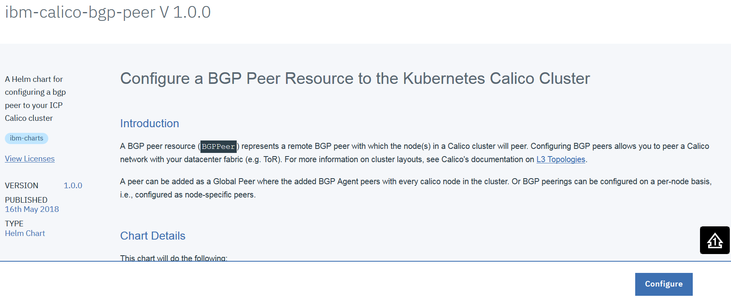
Helm and IBM Cloud Private
Catalog entries are Helm charts that can be deployed from the chart repositories.
Notes:
The App Catalog contains Helm Charts from Chart Repositories

Slide 9
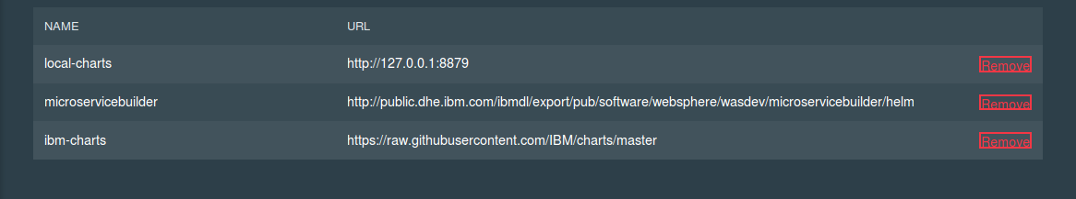
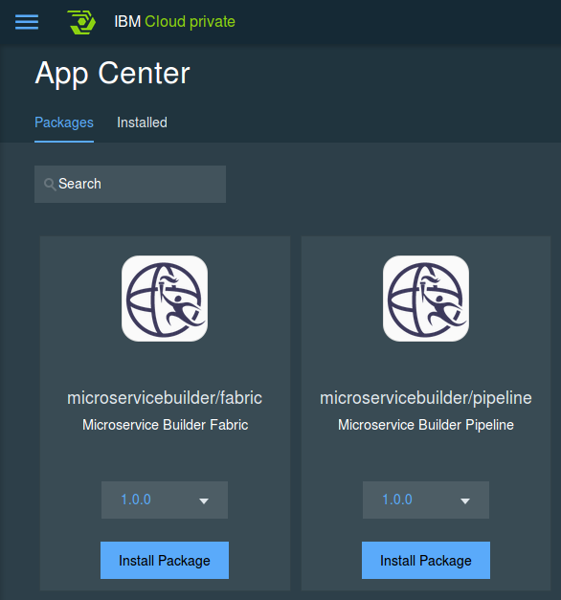
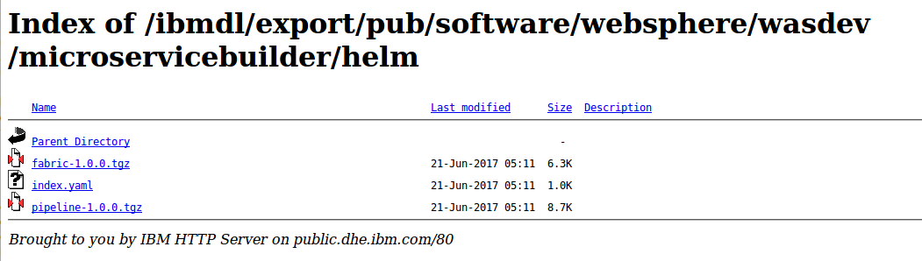
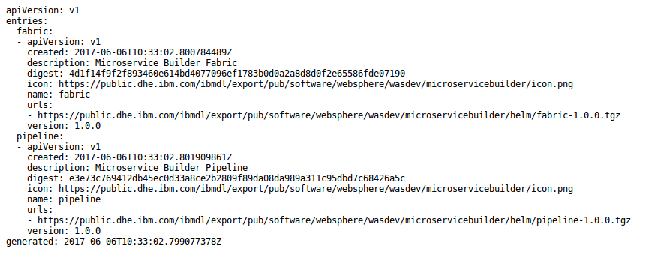
Chart repository
Chart repository:
HTTP server that houses an index.yaml file and optionally some packaged charts
Server can be any HTTP server that can serve YAML and tar files and can answer GET requests
To serve a local repo
$ helm serve
To add a chart to the repository, copy it to the directory and regenerate the index
$ helm repo index <charts-path>
Notes:
Chart repository is a web server with an index.yaml file
There are steps for adding a chart to a repository: copy, reindex
Also for the local repository in ICP
Adding your chart to local-repo:
on master, get helm container using `docker ps | grep helm`
copy your chart using `docker cp x.tar.gz <dockerID>:/local-repo`
Restart the container using docker restart <helm container id>
go to dashboard, click sync up repo, you will get your chart in app center

Slide 10
Deploying an application with its Helm chart
$ helm search mysql
NAME VERSION DESCRIPTION stable/mysql 0.1.1 Chart for MySQL
$ helm install stable/mysql
Fetched stable/mysql to mysql-0.1.1.tgz NAME: loping-toad LAST DEPLOYED: Thu Oct 20 14:54:24 2016 NAMESPACE: default STATUS: DEPLOYED
RESOURCES: ==> v1/Secret NAME TYPE DATA AGE loping-toad-mysql Opaque 2 3s
==> v1/Service NAME CLUSTER-IP EXTERNAL-IP PORT(S) AGE loping-toad-mysql 192.168.1.5 <none> 3306/TCP 3s
==> extensions/Deployment NAME DESIRED CURRENT UP-TO-DATE AVAILABLE AGE loping-toad-mysql 1 0 0 0 3s
==> v1/PersistentVolumeClaim NAME STATUS VOLUME CAPACITY ACCESSMODES AGE loping-toad-mysql Pending
Install output
Details about the release
Details about its resources
Chart
stable/mysql
Release name
loping-toad (auto generated)
Resources
Four total, one of each type
All named loping-toad-mysql
Secret
Service
Deployment
PersistentVolumeClaim

Slide 11
Overriding values
Default values are stored in the chart
<chart-path>/values.yaml
Helm CLI uses Kubernetes CLI’s configuration to connect to your current cluster
~/.kube/config
$ kubectl config view
To specify a release’s name, use the name flag
$ helm install --name CustomerDB stable/mysql
To deploy the release into a particular Kubernetes namespace, use the namespace flag
$ helm install --namespace ordering-system stable/mysql
To override an individual value, use the set flag
$ helm install --set user.name='student',user.password='passw0rd' stable/mysql
To override values with a values file, use the values or f flag
$ helm install --values myvalues.yaml stable/mysql

